Slide 1
C++ Function Overloading

Slide 2
C++ Function Overloading
In C++ programming, two functions can have same name if number and/or type of arguments passed are different.

Slide 3
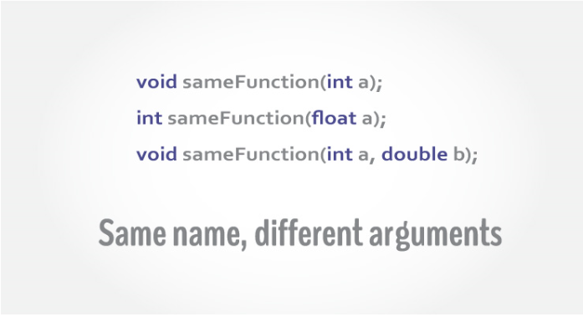
C++ Function Overloading

Slide 4
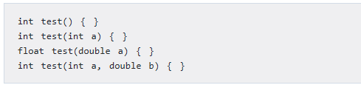

C++ Function Overloading
These functions having different number or type (or both) of parameters are known as overloaded functions. For example:
The number and type of arguments passed to these two functions are same even though the return type is different. Hence, the compiler will throw error.

Slide 5
C++ Function Overloading (Example)
#include <iostream>
using namespace std;
void display(int);
void display(float);
void display(int, float);
int main() {
int a = 5;
float b = 5.5;
display(a);
display(b);
display(a, b);
return 0;
}
void display(int var) {
cout << "Integer number: " << var << endl;
}
void display(float var) {
cout << "Float number: " << var << endl;
}
void display(int var1, float var2) {
cout << "Integer number: " << var1;
cout << " and float number:" << var2;
}

Slide 6
Rules for C++ Function Overloading
If two functions are having same number and types of arguments in the same order, they are said to have the same signature. Even if they are using distinct variable names, it doesn’t matter. For instance, following two functions have same signature.
void squar (int a, float b); //function 1
void squar (int x, float y);
//same function as that of function 1
Not function overloading

Slide 7
Rules for C++ Function Overloading
Functions with the same signature and same name but different return types are not allowed in C++.
You can have different return types, but only if the signatures are also different:
float square (float f);
double square (double d);
//different signatures, hence
//allowed
function overloading

Slide 8
If the signature of the two functions differ in either the number or type of their arguments, the two functions are considered to be overloaded.
Use function overloading only when a function is required to work for alternative argument types

Slide 9
CALLING OVERLOADED FUNCTIONS
Overloaded functions are called just like other functions. The number and type of arguments determine which function should be invoked.
For instance consider the following code fragment:
prnsqr (‘z’);
prnsqr (13);
prnsqr (134.520000012);
prnsqr (12.5F);

Slide 10
Display function for (int, float, string)
CALLING OVERLOADED FUNCTIONS
var
Main()
Display(var)

Slide 11
Display function for (int, float, string) input
void display(int var);
void display(float var);
void display(string var);
int main() {
int a=10;
float f=5.5;
string name="Hello";
display(a);
display(f);
display(name);
return 0;
}
void display(int var){
cout<<"Display integer :"<<var<<"\n";
}
void display(float var){
cout<<"Display float :"<<var<<"\n";
}
void display(string var){
cout<<"Display string:"<<var<<"\n";
}
(int)
Main()
Display(int var)
(float)
Display(float var)
(string)
Display(string var)

